Slide 1
Peripherals Configuration – SPORT, DAI, SPI & GPIO
26 Sept 2024

Slide 2
Serial PORT
Subheading

Slide 3
DAI – Digital Audio Interface
The Digital Audio Interfaces (DAIn) are comprised of groups of identical peripherals and their respective Signal Routing Units (SRUn).
The SRU connects inputs and outputs of the DAI peripherals with each other and to the external pins
DAI pins are of two types:-
There are 28 pins for DAI
14 pins for DAI0
14 pins for DAI1
In order to enable DAI pins we will use Control Registers called PADSO
DAI0
DAI1
Preg_PADSO_DAI0_IE
Preg_PADSO_DAI1_IE

Slide 4
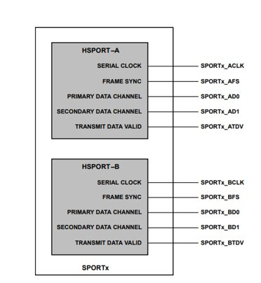
SPORT – Serial Port
Sport can receive or transmit serial data
Each sport can be split into two half as A and B.
Sports can be grouped as 0A ,0B to 7A ,7B.
Every sport has a serial BCLK and LRCLK.
DAI
SPORT
MEMORY
SPORT
DAI

Slide 5
SPORT – Configuration
The SPORT interface is a key feature in the ADSP-SC594 processor. It provides a high-speed, full-duplex, serial communication interface commonly used for connecting codecs, DSPs, and other serial devices, particularly in audio systems
To configure SPORT, you'll need to work with registers such as:
SPORT Control Registers: For enabling/disabling the interface, setting data word length, and specifying clocking options.
SPORT Channel Registers: Define the number of channels, TDM modes, and synchronization settings.
Transmit/Receive Buffers: Memory-mapped registers used to send and receive data over the SPORT interface

Slide 6
PCG (Precision Clock Generators)
The Precision Clock Generator (PCG) provides a flexible means of generating and routing clock signals within the processor. It is commonly used to provide clocking to peripherals like SPORT.
Features:
Precision Dividers: Allows precise clock generation.
Clock and Frame Sync Generation: Provides these signals for peripherals such as SPORT and others.
Internal and External Clocking: Can generate clocks from internal sources or accept external clock inputs.
Configuration:
PCG can be configured via the PCG control registers to set up the required clock rate, frame sync, and routing options for connected peripherals like SPORT.

Slide 7
SPI - Serial Peripheral Interface
Subheading

Slide 8
SPI – Introduction
SPI is a synchronous serial communication interface used for short distance communication.
It uses separate clock and data lines along with a select line.
During a data transfer the master always sends 8 to 16 bits of data to the slave, and the slave always sends a byte of data to the master.
The data can be transferred without interruption and many number of bits can be sent or received in a continuous stream.
It is a one master and multi slave communication.
SPI devices communicate in full duplex mode.

Slide 9
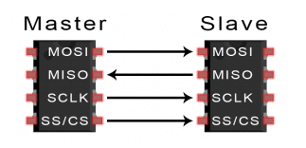
SPI – How Its work?
The SPI using two shift registers to form an inter-chip circular buffer.
To begin a communication, the master first configures the Clock, using a frequency less than or equal to the maximum frequency the slave device supports.
Such frequencies are commonly in the range of 1-70 MHz.
The master then pulls the slave select SSEL low for the desired chip.
During each SPI clock cycle, a full duplex data transmission occurs.
The master sends a bit on the MOSI line; the slave reads it from that same line.
The slave sends a bit on the MISO line; the master reads it from that same line.
Transmissions normally involve two shift registers of some given word size, such as eight bits, one in the master and one in the slave they are connected in a ring.
After that register has been shifted out, the master and slave have exchanged values.
If there are more data to exchange, the shift registers are loaded with new data and the process repeats.

Slide 10
GPIO (General Purpose Input Output)
Subheading

Slide 11
GPIO – Introduction
Generic Pin of an Microprocessor / Microcontroller
Can be Configured as either input or output
Operation can be Enabled / Disabled
Operating Levels: 1. High 2. Low
Output pins was writable and also can be readable.
Input pins are readable and writing over input pin
Pins configured as input also can be operate as interrupt
No Predefined operation / purpose

Slide 12
Assessment for Afternoon
Try to Configure I2S Input and TDM8 Output for SPORT and DMA Handling.
Write a Code to Set and Reset the GPIO Pin and Use GPIO pin to use as flag.
Write Code to configure SPI to copy Master Buffer to Slave buffer (i.e, Copy source to Destination buffer)

